Slide 1

Vehicle Insurance Details
BY
KESHAV MISHRA
1RN15IS043
ABHISHEK ANAND 1RN15IS003
PROJECT GUIDE - MRS VINUTHA G.K

Slide 2
INTRODUCTION
File Structures is the organization of Data in Secondary Storage devices in such a way that minimizes the access time and the storage space and is a combination of representations for data in files and of operations for accessing the data.
A File structure allows applications to read, write and modify and search for data.
The vehicle database has been designed to easily maintain the data of the loan customers. The project was aimed at computerizing the process of maintaining user records.
Users are provided with the facility to add new records, delete the existing records, search for a particular customer’s details and also modify details.
Each user is identified by a primary key, which in this case is the chassis no.

Slide 3
FIELD AND RECORD STRUCTURE
The project is designed using the concept of variable length records delimited by an endline character.
A variable length record is one which differs in length from other records in the file. The records within a file are followed by a delimiting field which differs each record from one another.
The fields within a record are also followed by a delimiting byte since each field within a record can have different sizes.
Record1 | # | Record2 | # | Record3 | # | Record4 | # | Record5 | #
File1 | File2 | File 3 | File 4 | File 5

Slide 4
FILEDS USED IN THIS PROJECT
Chassis no. – field of size 10, variable of type char, stores the chasis number.
VName – field of size 30, variable of type char, used to store the name of the vehicle.
VAddr – field of size 40, variable of type char, holds the permanent address of the vehicle.
Vprice - field of size 25, variable of type char, holds the price of the customer.
VBrand- field of size 11,variable of type char, stores the brand details of the vehicle.

Slide 5
B-Tree Properties‡
Properties
maximum branching factor of M
the root has between 2 and M children or at most L keys
other internal nodes have between ⎡M/2⎤ and M children
internal nodes contain only search keys (no data)
smallest datum between search keys x and y equals x
each (non-root) leaf contains between ⎡L/2⎤ and L keys
all leaves are at the same depth
Result
tree is Θ(log n) deep
all operations run in Θ(log n) time
Notes:
The properties of B-Trees (and the trees themselves) are a bit more complex than previous structures we’ve looked at.
Here’s a big, gnarly list; we’ll go one step at a time.
The maximum branching factor, as we said, is M (tunable for a given tree).
The root has between 2 and M children or at most L keys.
(L is another parameter)
These restrictions will be different for the root than for other nodes.

Slide 6
Example
B-Tree with M = 4
and L = 4
10
40
3
15
20
30
50
1
2
10
11
12
20
25
26
40
42
3
5
6
9
15
17
30
32
33
36
50
60
70
Notes:
This is just an example B-tree. Notice that it has 24 entries with a depth of only 2.
A BST would be 4 deep.
Notice also that the leaves are at the same level in the tree. I’ll use integers as both key and data, but we all know that that could as well be different data at the bottom, right?

Slide 7
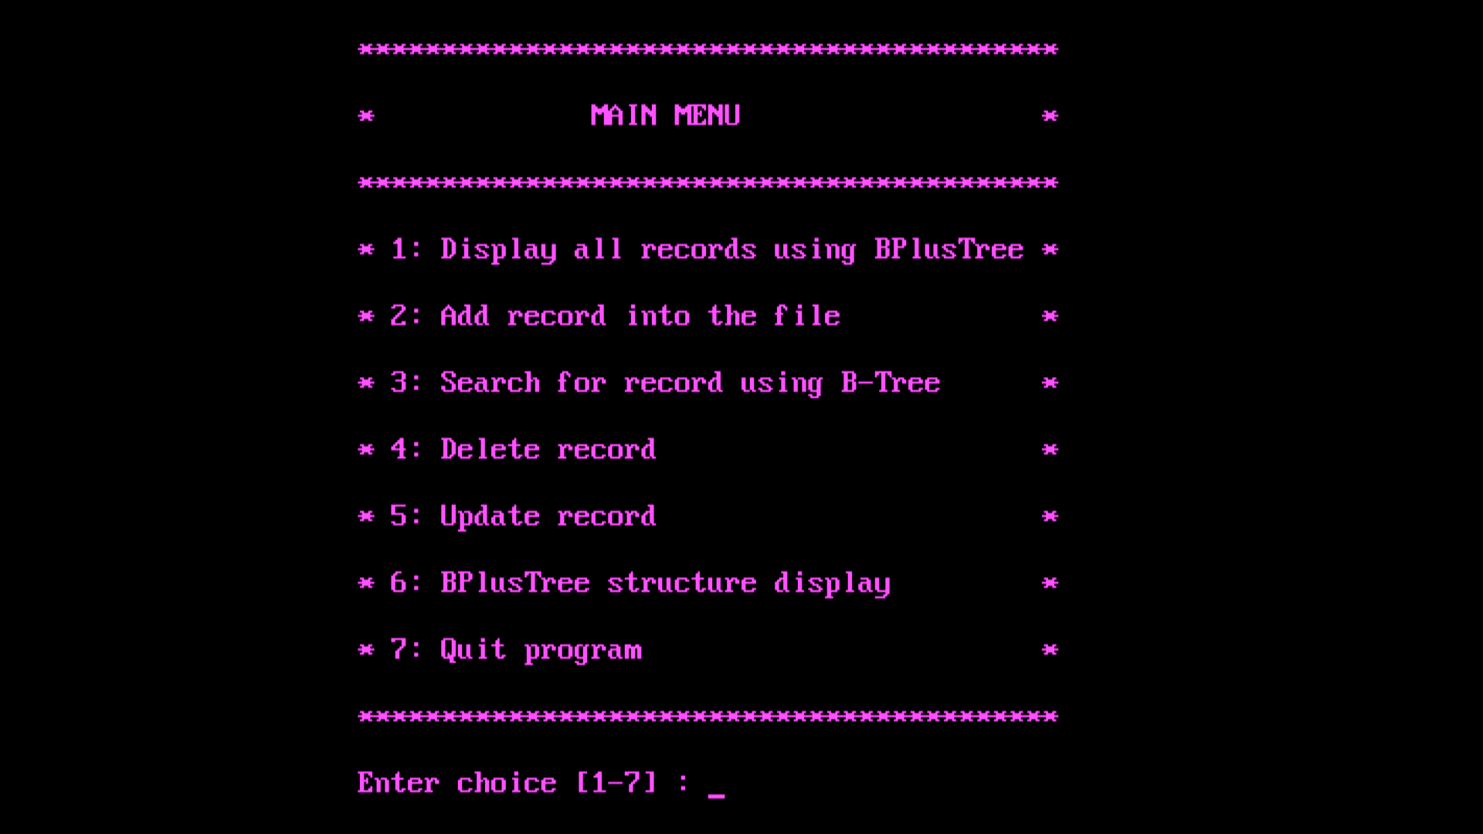
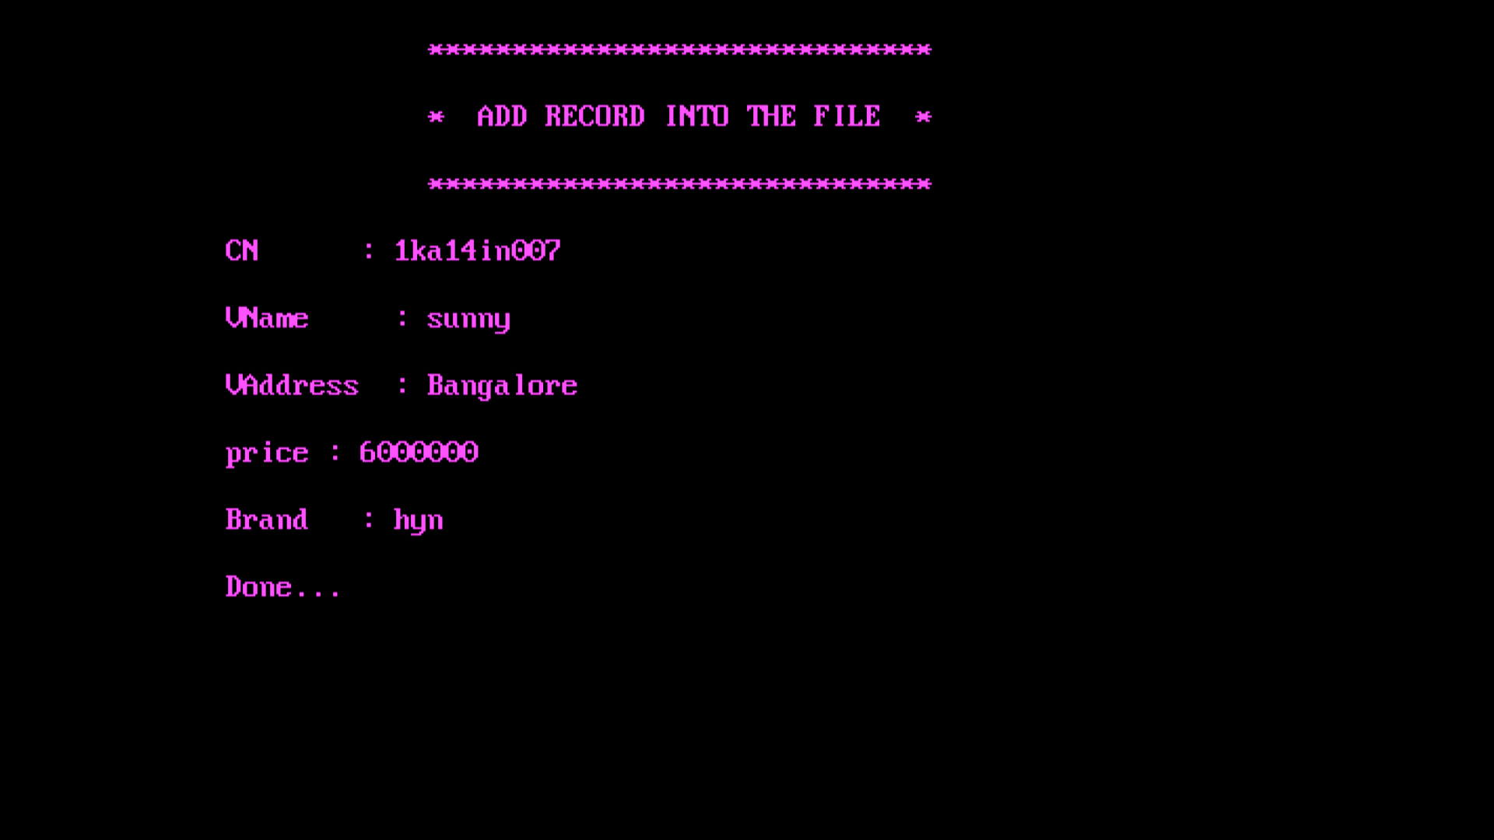
SNAPSHOTS
Menu page
Record Addition Section

Slide 8
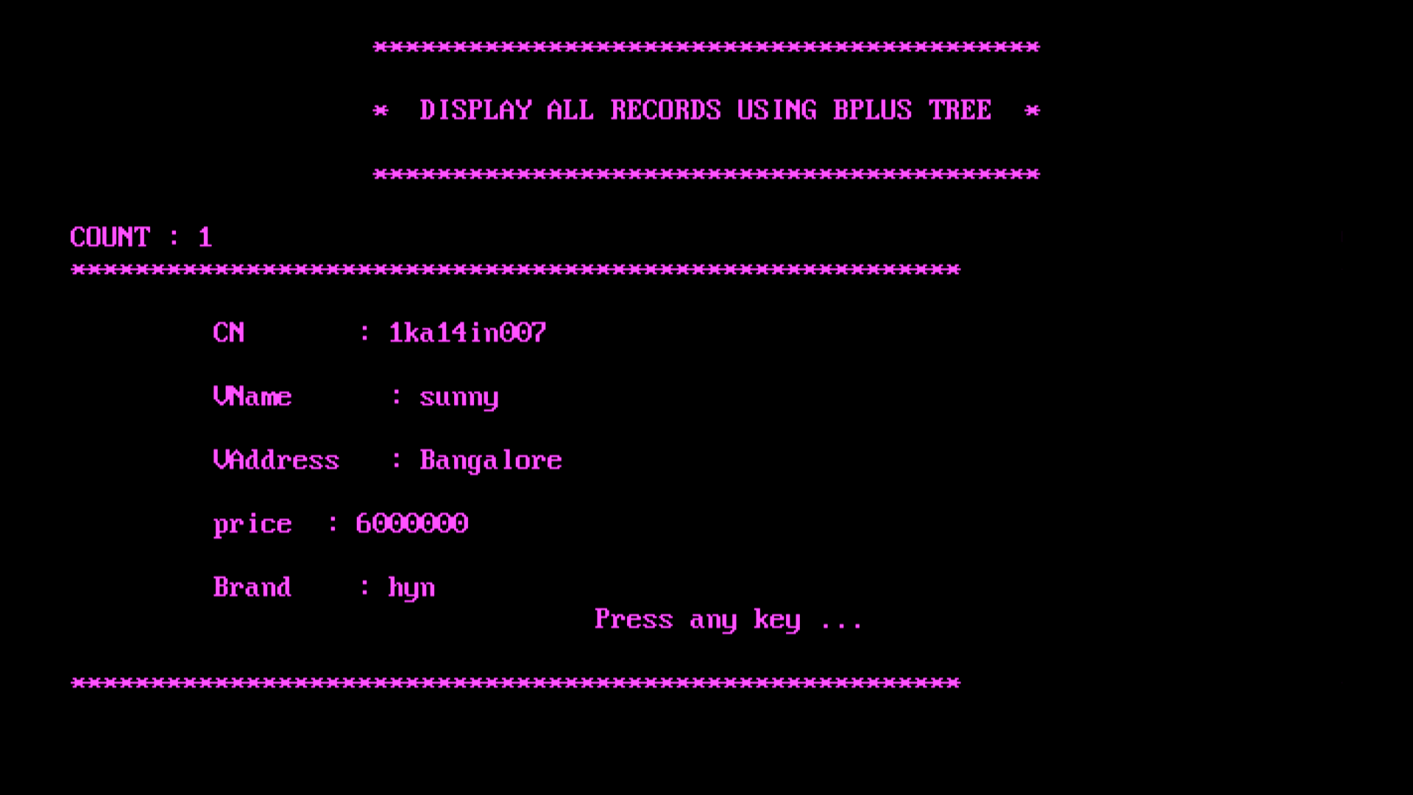
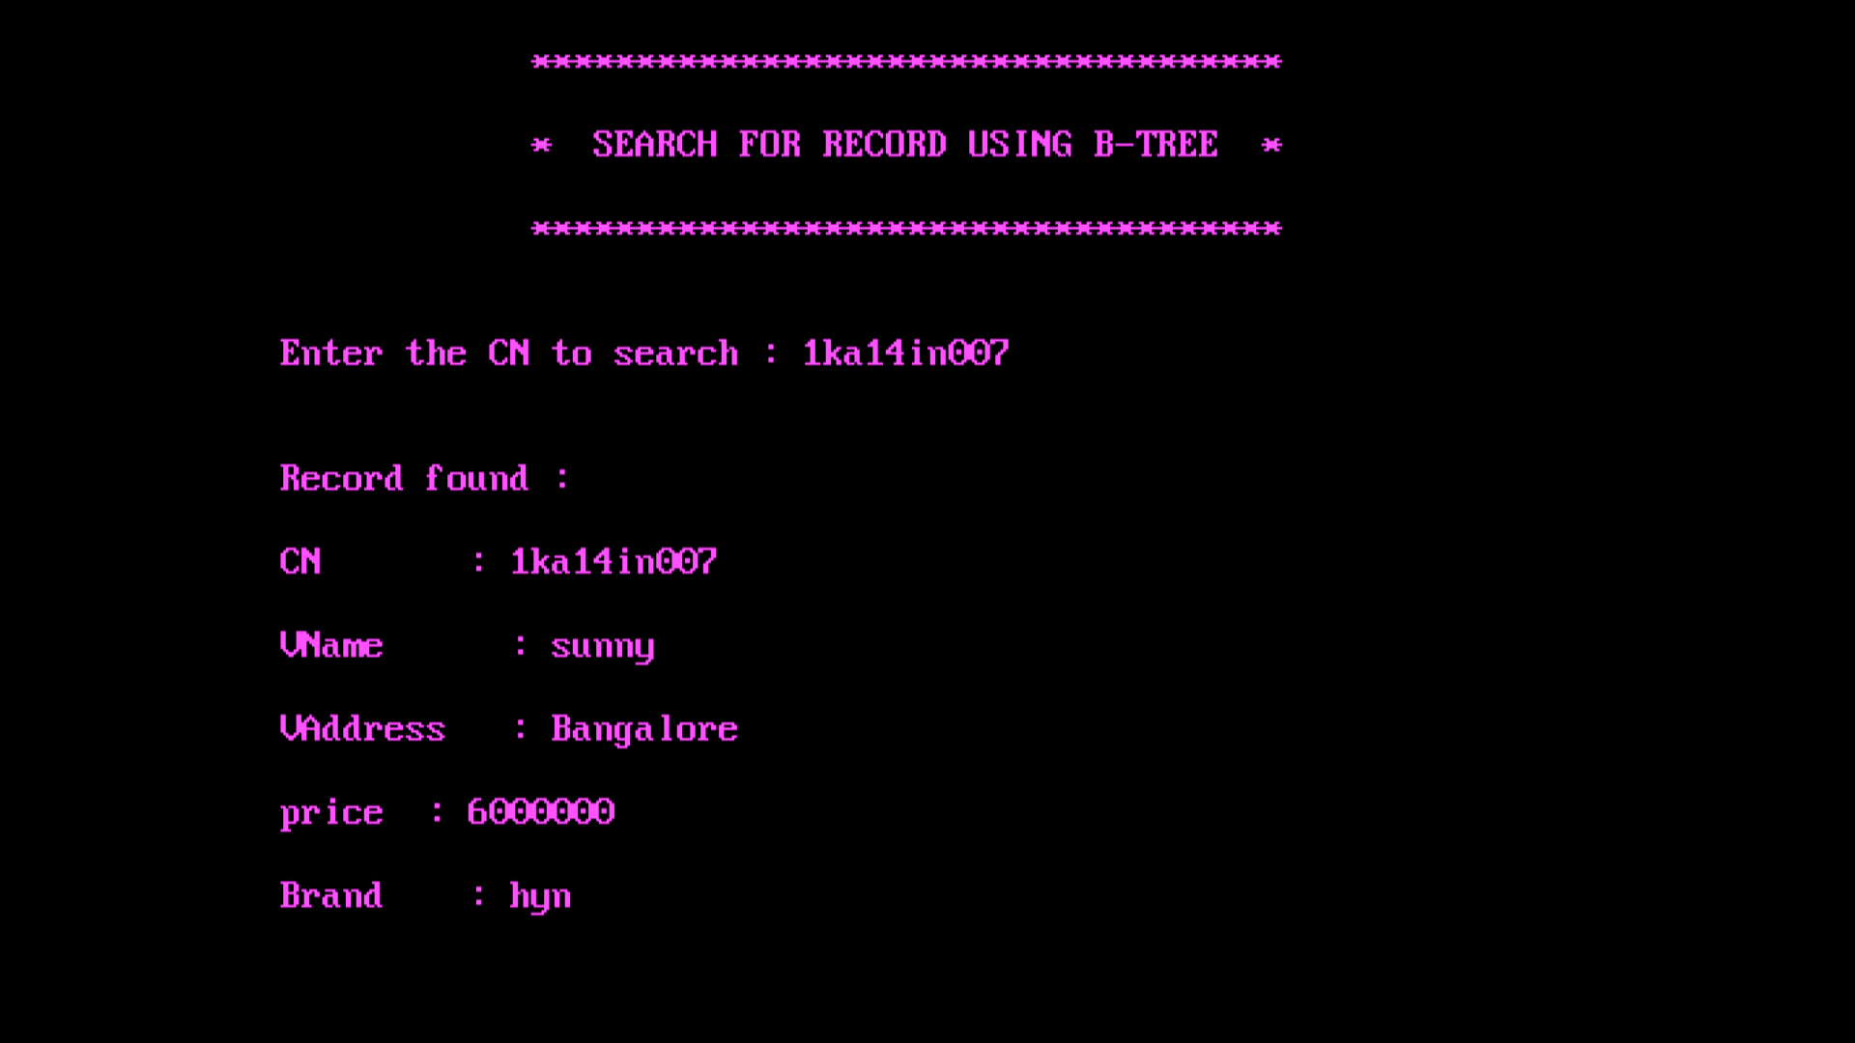
Displaying Existing Record
Searching the Existing Record

Slide 9
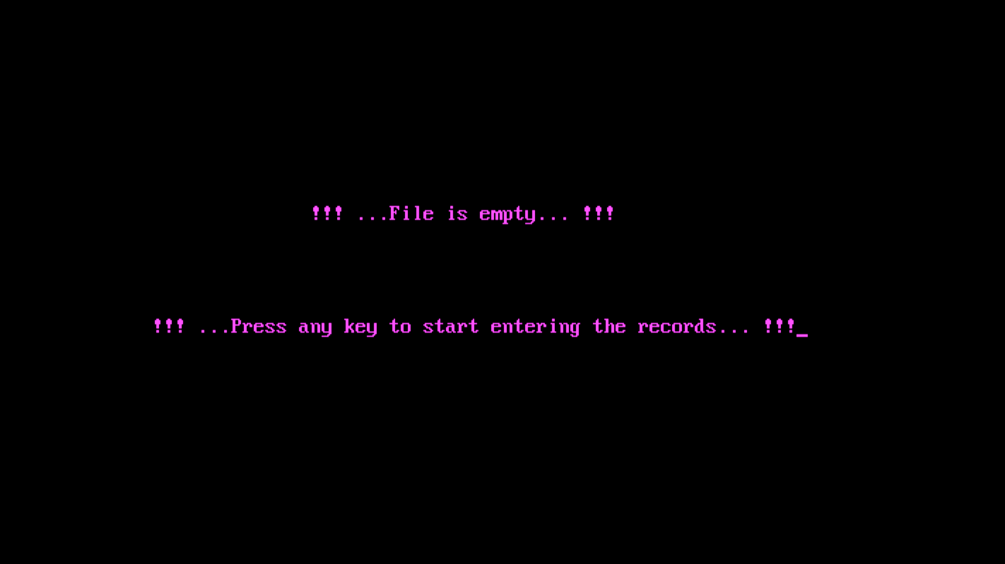
When records are not there

Slide 10
CONCLUSION
It is a software which helps the user to work with the vehicle insurance company and their branches easily.
This software reduces the amount of manual data entry and gives greater efficiency. The User Interface of it is very friendly and can be easily used by anyone.
It also decreases the amount of time taken to write customer’s details and other modules.
At the end, we can say that this, software is performing all the tasks accurately and is doing the work for which it is made.

